Slide 1
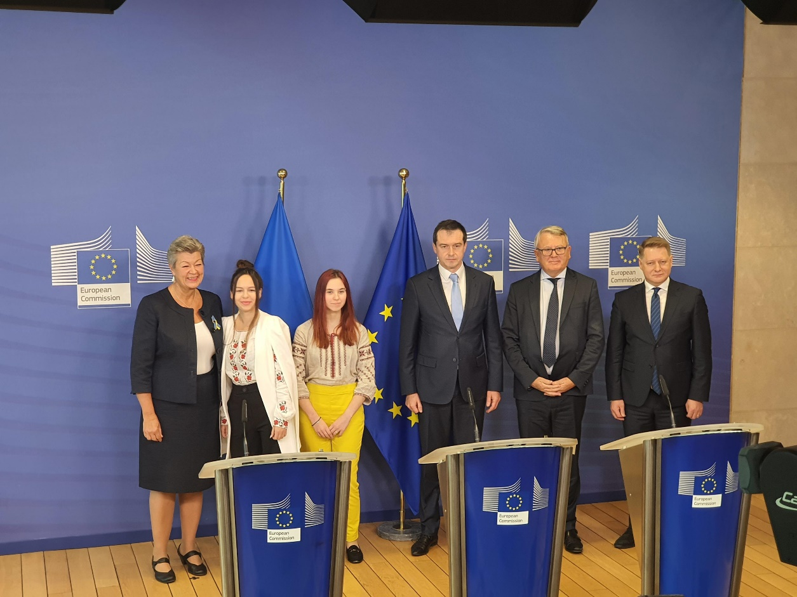
Official launch – 10 October
Press Point recording (approx. 30 min): https://audiovisual.ec.europa.eu/en/video/I-231108
Press release: “Solidarity with Ukraine: EU takes new steps to provide certainty and access to employment to beneficiaries of Temporary Protection”: https://ec.europa.eu/commission/presscorner/detail/en/ip_22_5998
News in EURES portal: https://eures.ec.europa.eu/fleeing-war-ukraine-eu-talent-pool-pilot-can-help-you-find-job-eu-2022-10-10_en
News in the ELA website: https://www.ela.europa.eu/en/news/powered-eures-eu-talent-pool-pilot-initiative-supports-ukrainian-jobseekers-find-job-eu
Photos from the press point: https://audiovisual.ec.europa.eu/en/reportage/P-059098

