Slide 1
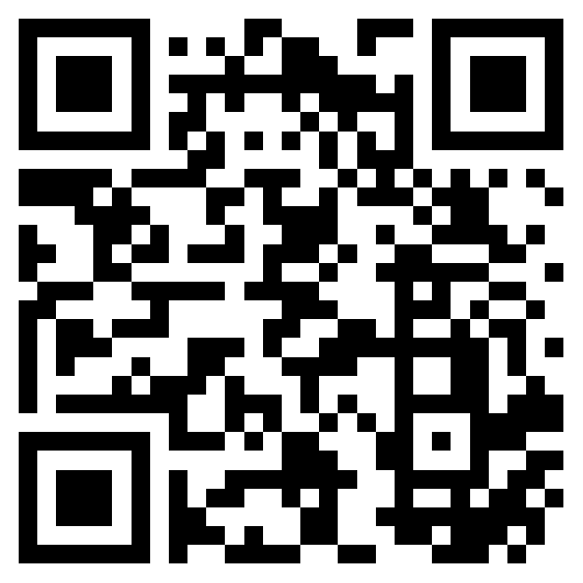
Update on the state of play
of the EU Talent Pool Pilot development
ec.europa.eu/eures/public/eu-talent-pool-pilot_en
Notes:
Title Slide.

Slide 2
Topic 3
Communication plan
Notes:
Divider Slide

Slide 3
Communication objectives
To facilitate a successful labour market integration of protection beneficiaries fleeing Ukraine.
Raise awareness for the EURES portal and EURES network at EU level.
Notes:
Content Main Slide

Slide 4
Target audiences
Temporary protection jobseekers (People fleeing Ukraine)
EU Employers: Social media direct messaging, Employer’s Associations: Business Europe, SMEUnited, EuroChambers, SGI Europe; Trade unions
Multipliers: Ukrainian diaspora and its organizations, EMN, EU networks (PES network)
Stakeholders: MS’s labour and immigration authorities, EU Institutions, ILO.

Slide 5
Key messages
EU Talent Pilot – bringing together jobseekers and employers
EU Talent Pilot – Finding a job in the European Union
EU Talent Pilot – Search for work and workers
EU Talent Pilot = Your European job platform
EU Talent Pilot – Find the right(s) job
EU Talent Pilot – Search, Find, Match your job in the European Union

Slide 6
Timeline
Launch
All templates
available
Assessment
October
November
February
March
Launch – Phase I
Roll out – Phase II
Wrap-up – Phase III
End or continuation

Slide 7
Graphic image

Slide 8
Communication Activities
Launch event with Commissioners from DG HOME + DG EMPL and ELA Executive Director on 10 October;
Q&A published on the landing page and share with EURES helpdesk;
EU Login guidance materials translated in UA and RU (PDF guide, FAQ and Video)
Media work, within the launch event: join press release by the CE and ELA;
Articles: ELA website, EURES portal, EURES extranet and both EURES&You and Inside EURES newsletters;
Social media campaign, (6 months) 10 October 2022 – March 2023; 2 posts a week
Video of testimonials to be released on a later stage.
Notes:
Content Main Slide

Slide 9
Activities
Leaflet and a poster to distribute in welcome centres;
Direct messaging to Ukrainians through Telegram
Direct message to Employers and multipliers through social media direct mailing
All communication deliverables will be shared with the MS, stakeholders involved, on the extranet folder campaigns – Talent Pool Pilot.
Notes:
Content Main Slide

Slide 10
Available templates
General visual horizontal (format A4, different use e.g. web page, article, newsletter)
General visual vertical (format A4, different use e.g. web page, article, newsletter)
Facebook visual (1,200 x 630 pixels)
Instagram visual: post – square (1080px by 1080px)
Instagram visual: story – vertical (1080 pixels wide by 1920 pixels height - a 9:16 aspect ratio)
Twitter visual – post (1200 x 675 pixels)
LinkedIn visual – post (1200 x 1200 pixels)
= will be templates that could be adjusted according to needs!

Slide 11
Topic 4
How can you get involved?
Notes:
Divider Slide

Slide 12
How can you get involved?
Follow and reshare, comment the social media posts;
Create page or section on your website based on the EURES portal landing page;
Contact directly interested stakeholders and networks in your country: Employers organisations, Unions, employment, Ukrainian embassy, Ukrainian NGOs in your country;
Create a link on your website to the landing page;
Use the materials, made available on the landing page;
Or you can access the extranet and use not only the translated materials but also Templates.

Slide 13
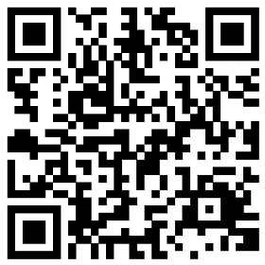
ec.europa.eu/eures/public/eu-talent-pool-pilot_en
Notes:
Content Main Slide

